Slide 1
NeuroViz
AI Product Imaging Infrastructure for E-Commerce
Usage-based platform serving 26,000+ sellers with 85%+ gross margins
$200K+ ARR
85%+
3,595%
26K
Revenue
Gross Margins
YoY MRR Growth
Registered Users
Raising $500K - $1M | Seed Round | March 2026
neuroviz.ai

Slide 2
01
THE PROBLEM
25-30M Online Sellers Need Professional Visuals. Most Can't Afford Them.
$200-2K+
40%
Cost per professional photo shoot. Prohibitive for small sellers who need hundreds of product images.
Boost in conversions from high-quality product visuals. Poor photos directly kill sales.
4.8M+
24/7
Shopify stores alone, each needing hundreds of product images. Plus Etsy, eBay, Amazon sellers.
Social commerce demands constant fresh visual content. Sellers can't hire a photographer for every post.

Slide 3
02
THE SOLUTION
AI Imaging Infrastructure.
Pay Per Use. No Waste.
NeuroViz is an AI infrastructure platform for e-commerce product imaging. Sellers use it when they need it -- for catalog launches, seasonal campaigns, new product lines. Usage-based pricing means they pay for what they consume, not for a seat they may not use next month.
15+ Specialized Apps
Photography-Grade Realism
Multi-Model Architecture
Usage-Based Pricing
Jewelry retouching, virtual try-on, creative photography, fashion studio, video generation, and more.
Real lighting simulation, reflections, shadows. Built by a 20-year commercial photographer.
Proprietary backend selects the optimal AI model for each task. Best output, lowest cost.
Credit packs from $10. No subscriptions required. Buy what you need, use when you need it.

Slide 4
03
PRODUCT
AI Retouching Studio & Virtual Try-On
Upload a phone photo. Get studio-quality retouching, virtual try-on, creative photography, and product video -- all in seconds.
Jewelry Retoucher Pro
Virtual Try-On
Creative Photographer
V2/V3/V4 with increasing fidelity
Rings, earrings, necklaces, bracelets
Lifestyle product photography
20 credits
15 credits
15 credits
Fashion Model Studio
Image to Video
Background Removal
Full-body model product display
5-sec product video from still
Clean extraction + edge refinement
15 credits
60 credits
10 credits

Slide 5
04
TECHNOLOGY
Beyond Backgrounds:
AI That Understands Professional Lighting
Reflection Simulation
COMPETITIVE MOAT
Accurate surface reflections that respond to the generated environment.
Alex Koloskov's 20+ years of professional product photography is embedded in how the AI models are trained and configured.
Competitors can access the same base models. Nobody else has our prompt engineering, training data, photography expertise, or understanding of what makes a product image convert.
The models are commodities. The application layer is the moat.
Environmental Lighting
Products near candles show warm reflections. Context-aware rendering.
Shadow Physics
Shadows match light sources. No more floating product composites.
Detail Preservation
Labels, logos, gemstone facets, metal textures maintained through generation.

Slide 6
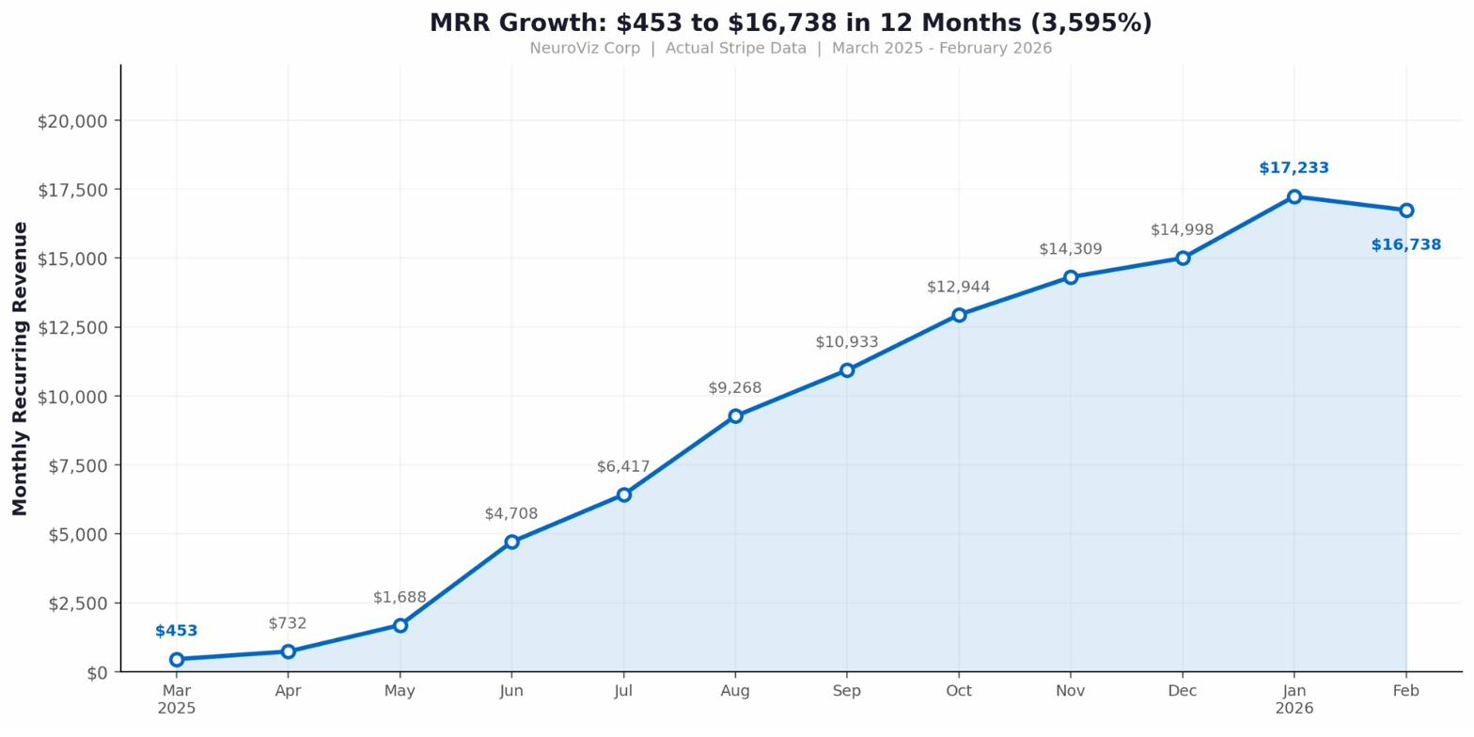
05
TRACTION
3,595% MRR Growth in 12 Months
From $453 to $16,738 MRR. Built on a $50K bootstrap with a 4-person team. No VC money. No sales team.

Slide 7
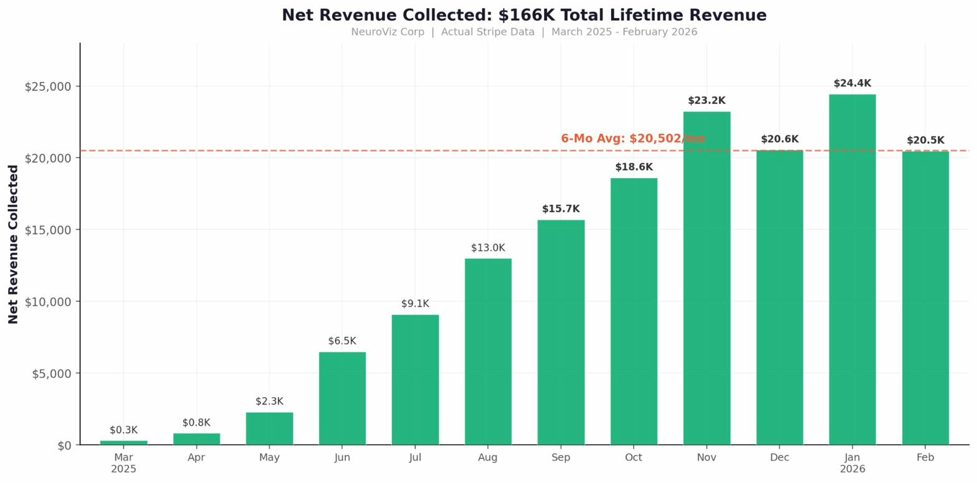
06
REVENUE
$166K Total Revenue Collected
$20.5K
Avg. monthly net revenue (6 mo)

Slide 8
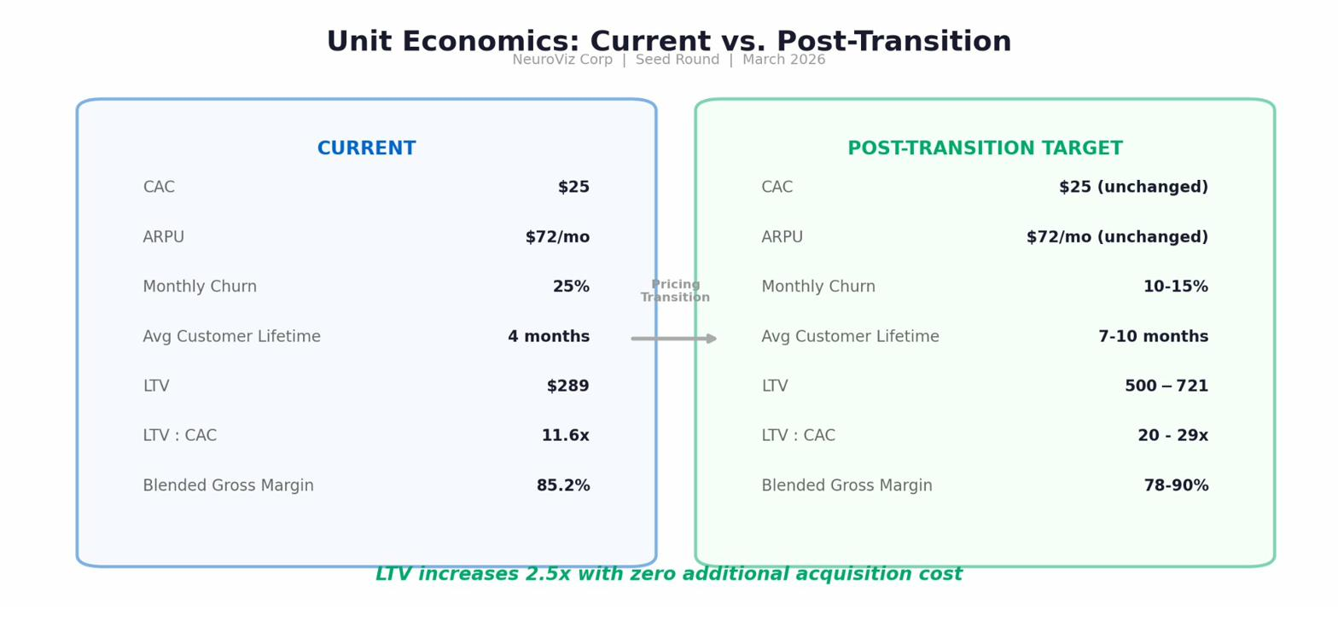
07
UNIT ECONOMICS
Usage Economics: 85% Margins at Every Scale
As we transition from subscription to usage-based pricing, customer lifetime extends from 4 months to 7-10+ months. Same $25 acquisition cost. Same revenue per user. Dramatically longer engagement.

Slide 9
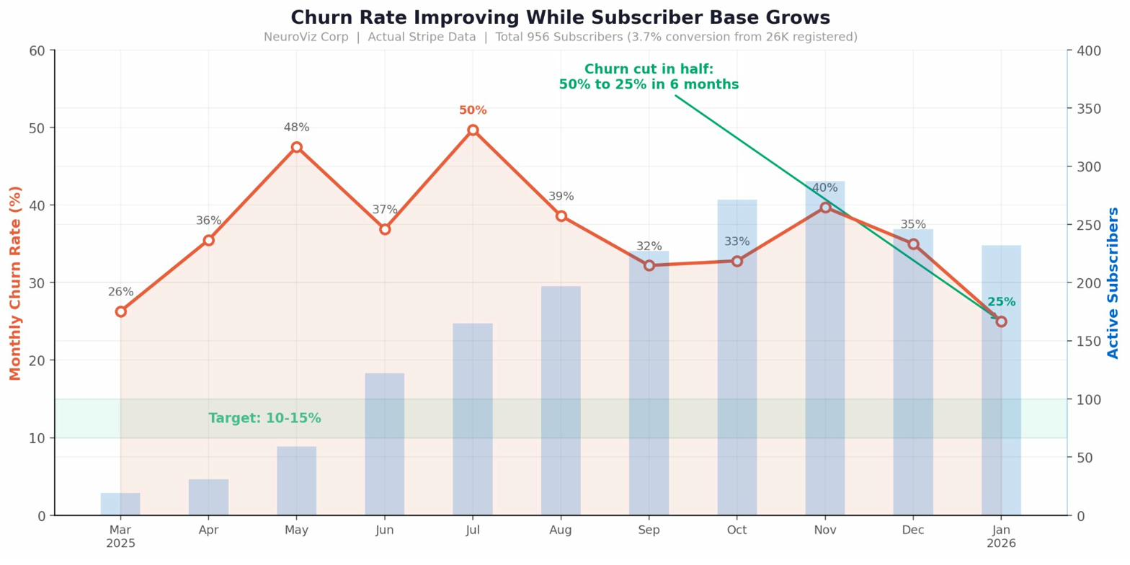
08
BUSINESS MODEL EVOLUTION
From Subscription SaaS to
AI Usage Platform
WHAT WE LEARNED
Our users are project-based, not seat-based. A jewelry brand needs 8,000 images for a catalog launch, then 500 the next month. Forcing monthly subscriptions creates waste and cancellations. This is not a product problem -- it is a business model insight.
THE PIVOT
Usage-based credit packs ($10-$1,000) replace fixed subscriptions. Credits never expire. No waste. $19/mo premium membership provides 25% savings for power users. Platform stays available between projects.
THE RESULT
26K registered users become a reactivation pool.
LTV increases from $289 to $500-721.
Revenue shifts from churn-exposed to usage-driven.

Slide 10
09
CASE STUDY: SUSTAINED PLATFORM USAGE
Huesis.com: Ongoing Revenue
from a Single Platform Partner
WHITE-LABEL PARTNERSHIP
WHAT THIS PROVES
Huesis.com (Spectrum Unlimited Inc.) runs a fully branded version of the NeuroViz platform under their own brand. They serve their own customer base with NeuroViz technology -- no NeuroViz branding visible to end users.
Sustained multi-month usage
Not a one-time project. Huesis has been an active paying partner for months, using the platform continuously.
Premium pricing acceptance
50/50
$6,000
Paying development fees, monthly hosting, and revenue share. Validates willingness to pay for quality AI imaging infrastructure.
Revenue split on net revenue
One-time development fee
Scalable distribution model
Each white-label partner brings their own customer base. NeuroViz earns dev fees + hosting + 50% revenue share without additional marketing spend.
$200/mo
12 months
Hosting fee (recurring)
Contract term, auto-renewing
Repeatable template
2-3 weeks to customize per partner. The white-label model is designed to scale to multiple partners across verticals.

Slide 11
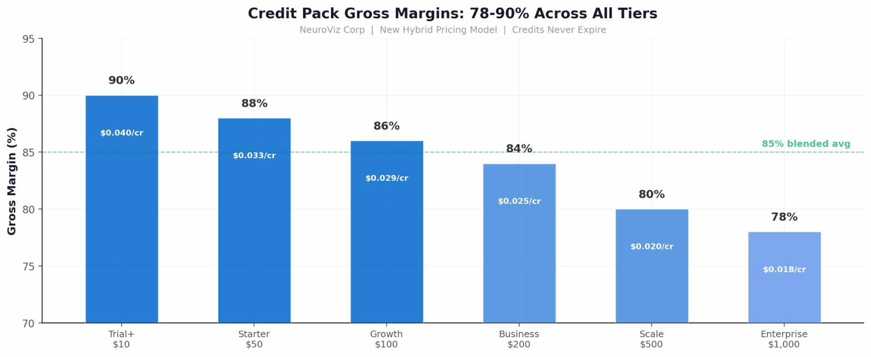
10
USAGE-BASED PRICING
78-90% Gross Margins Across All Tiers
Credit packs from $10 to $1,000. No subscription required. Credits never expire. Volume discounts on larger packs. Margins stay strong even at enterprise pricing.

Slide 12
11
MARKET
Massive Market. Clear Beachhead.
$7.5T
25-30M
E-Commerce Market
SMBs Selling Online
Projected by 2026. Every seller needs product images.
Core target. Underserved by current tools.
$50B
$10B
AI-Generated Content
Freelance Photography
Projected by 2026. NeuroViz rides this wave.
Disruption target. AI replaces routine shoots.

Slide 13
12
COMPETITION
Not Competing with Midjourney.
Replacing the Photo Studio.
 | NeuroViz | Photoroom | Midjourney | Leonardo AI
Studio-quality lighting | Yes | No | No | No
Product detail preservation | Yes | Partial | No | No
Virtual try-on | Yes | No | No | No
Jewelry specialization | Yes | No | No | No
Video generation | Yes | No | No | Limited
Usage-based (no sub required) | Yes | Free* | $10/mo | Free*
White-label infrastructure | Yes | No | No | No

Slide 14
13
GROWTH STRATEGY
Five Growth Levers. Clear Path to Scale.
1
Usage-Based Pricing
Launching now
Credit packs open revenue from 26K registered users who never subscribed. $10 entry point.
2
White-Label Partners
First partner live
Proven with Huesis.com. Each partner brings own customer base. $6K dev + hosting + 50% rev share.
3
Mobile Apps
Roadmap Q2-Q3
Majority of Etsy/Shopify sellers manage stores from phones. Unlocks massive user segment.
4
Shopify Plugin
Roadmap Q2-Q3
Direct integration into 4.8M+ stores. In-context usage drives higher adoption.
5
AI Marketplace
Roadmap 2026
Open backend to external developers. Platform play with revenue share on every transaction.

Slide 15
14
THE ASK
Raising $500K - $1M
The business generates cash. The money scales distribution.
40%
Marketing & Acquisition
30%
Engineering
$25 CAC with 11.6x LTV:CAC. Every dollar returns $11.60.
Mobile apps, Shopify plugin, white-label expansion, API.
20%
Team
10%
Operations
Targeted hires in engineering and growth. Modest founder compensation.
Infrastructure scaling, legal, and working capital.
At $25 CAC and projected $721 LTV post-transition, every marketing dollar returns $29.

Slide 16
15
TEAM
4 Co-Founders. 70+ Years Combined Experience.
Alex Koloskov
Yura Loznewski
Genia Larionova
Robert Webster
Co-founder & CEO
Co-founder & CTO
Co-founder & COO
Co-founder & CFO
Co-founder of Photigy. 20+ years product photography. 10 years software engineer at Verizon. 2M followers.
10+ years software engineering & cloud architecture. Machine learning and big data expertise.
Co-founder of Photigy (18 years). 20+ years marketing & management. Expert retoucher.
Licensed CPA. Fintech entrepreneur & investor. Multi-state NMLS MLO. CA Real Estate Broker.

Slide 17
NeuroViz
Let's talk.
Alex Koloskov, CEO
Email:
admin@neuroviz.ai
Phone:
669-237-7989
Website:
neuroviz.ai

